Slide 1

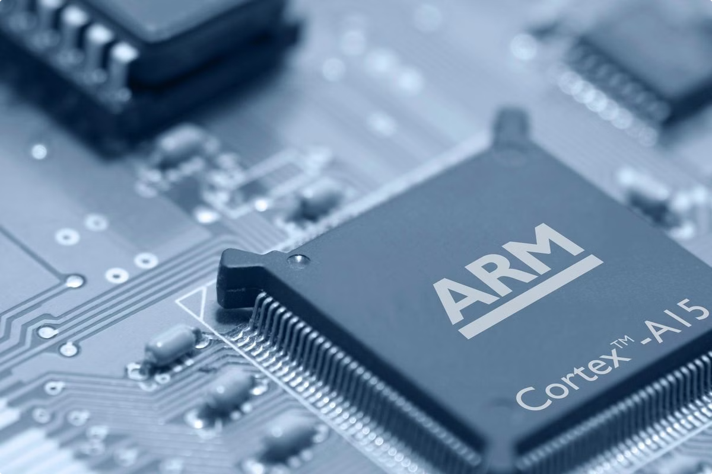
Software Interrupts in ARM Processors
This presentation will provide an overview of software interrupts in ARM processors, exploring their functionality, importance in embedded systems, and various applications.

Slide 2

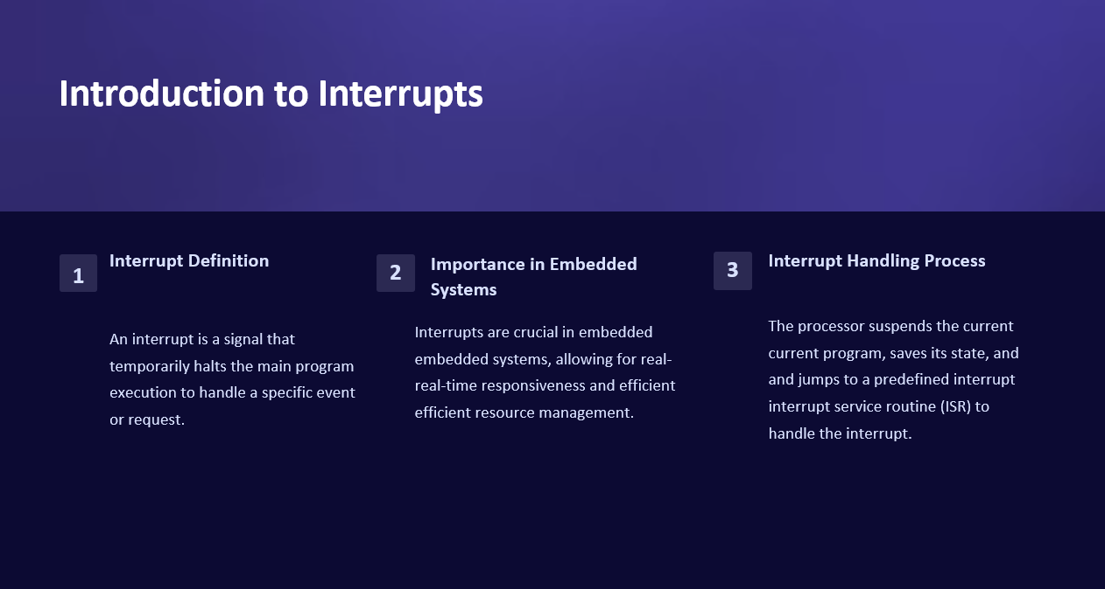
Introduction to Interrupts
Interrupt Definition
Importance in Embedded Systems
3
Interrupt Handling Process
1
2
Interrupts are crucial in embedded systems, allowing for real-time responsiveness and efficient resource management.
The processor suspends the current program, saves its state, and jumps to a predefined interrupt service routine (ISR) to handle the interrupt.
An interrupt is a signal that temporarily halts the main program execution to handle a specific event or request.

Slide 3
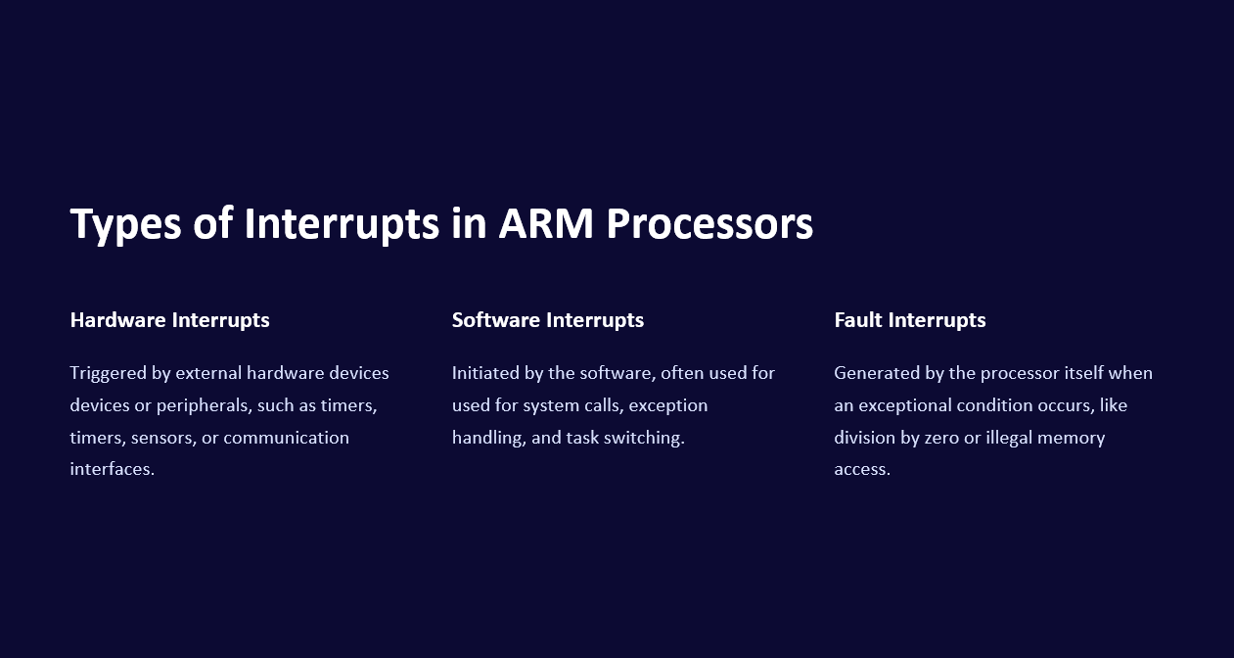
Types of Interrupts in ARM Processors
Hardware Interrupts
Software Interrupts
Fault Interrupts
Triggered by external hardware devices or peripherals, such as timers, sensors, or communication interfaces.
Initiated by the software, often used for system calls, exception handling, and task switching.
Generated by the processor itself when an exceptional condition occurs, like division by zero or illegal memory access.

Slide 4
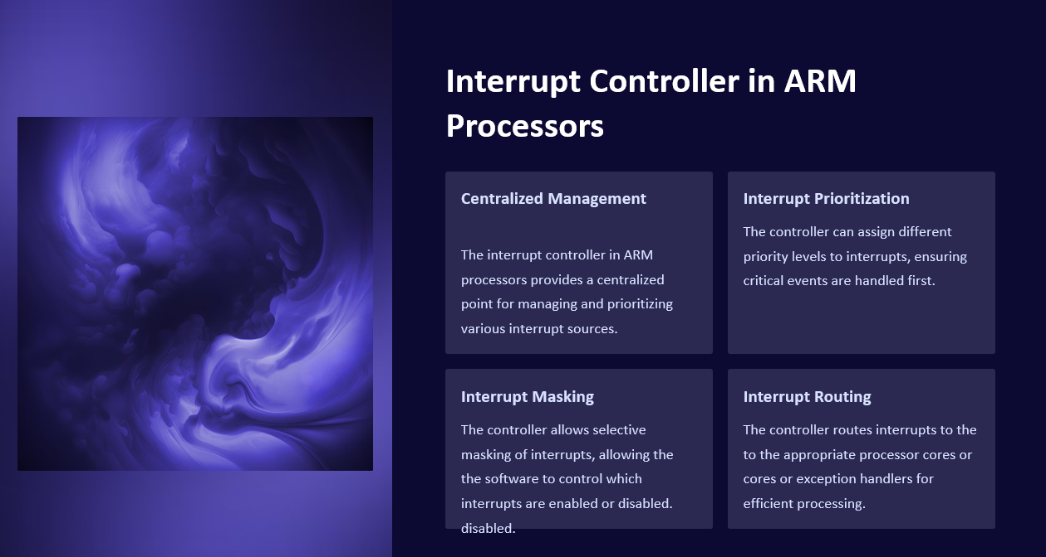


Interrupt Controller in ARM Processors
Centralized Management
Interrupt Prioritization
The controller can assign different priority levels to interrupts, ensuring critical events are handled first.
The interrupt controller in ARM processors provides a centralized point for managing and prioritizing various interrupt sources.
Interrupt Masking
Interrupt Routing
The controller allows selective masking of interrupts, allowing the software to control which interrupts are enabled or disabled.
The controller routes interrupts to the appropriate processor cores or exception handlers for efficient processing.

Slide 5
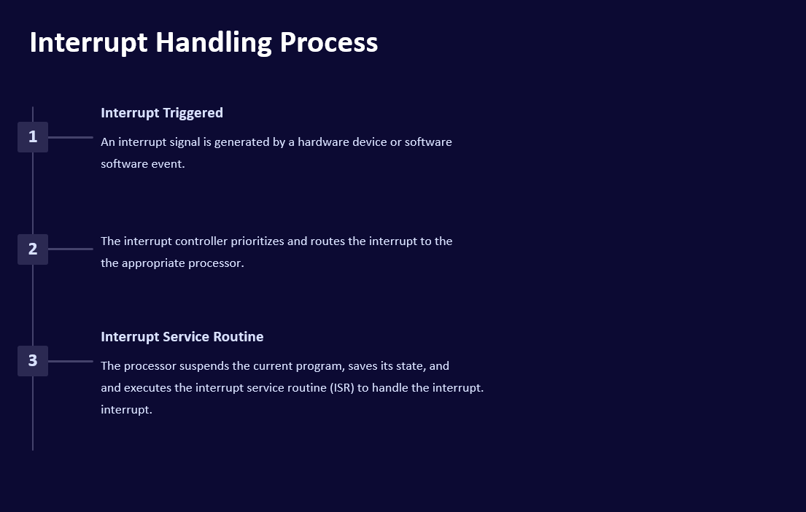
Interrupt Handling Process
Interrupt Triggered
1
An interrupt signal is generated by a hardware device or software event.
The interrupt controller prioritizes and routes the interrupt to the appropriate processor.
2
Interrupt Service Routine
3
The processor suspends the current program, saves its state, and executes the interrupt service routine (ISR) to handle the interrupt.

Slide 6
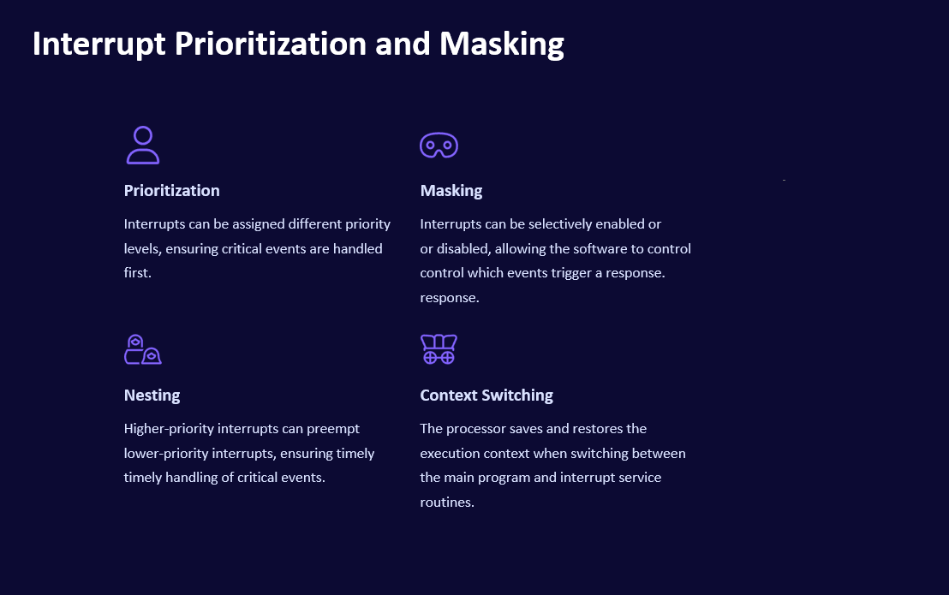




Interrupt Prioritization and Masking
Prioritization
Masking
Interrupts can be assigned different priority levels, ensuring critical events are handled first.
Interrupts can be selectively enabled or disabled, allowing the software to control which events trigger a response.
Nesting
Context Switching
Higher-priority interrupts can preempt lower-priority interrupts, ensuring timely handling of critical events.
The processor saves and restores the execution context when switching between the main program and interrupt service routines.

Slide 7
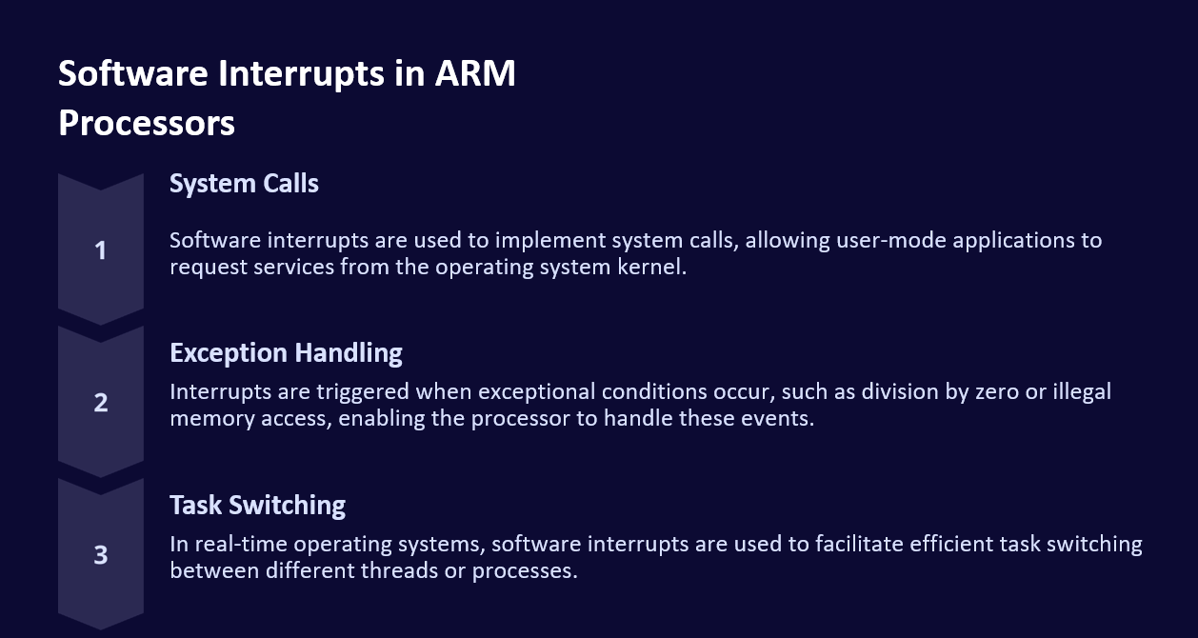



Software Interrupts in ARM Processors
System Calls
Software interrupts are used to implement system calls, allowing user-mode applications to request services from the operating system kernel.
Exception Handling
Interrupts are triggered when exceptional conditions occur, such as division by zero or illegal memory access, enabling the processor to handle these events.
Task Switching
In real-time operating systems, software interrupts are used to facilitate efficient task switching between different threads or processes.

Slide 8
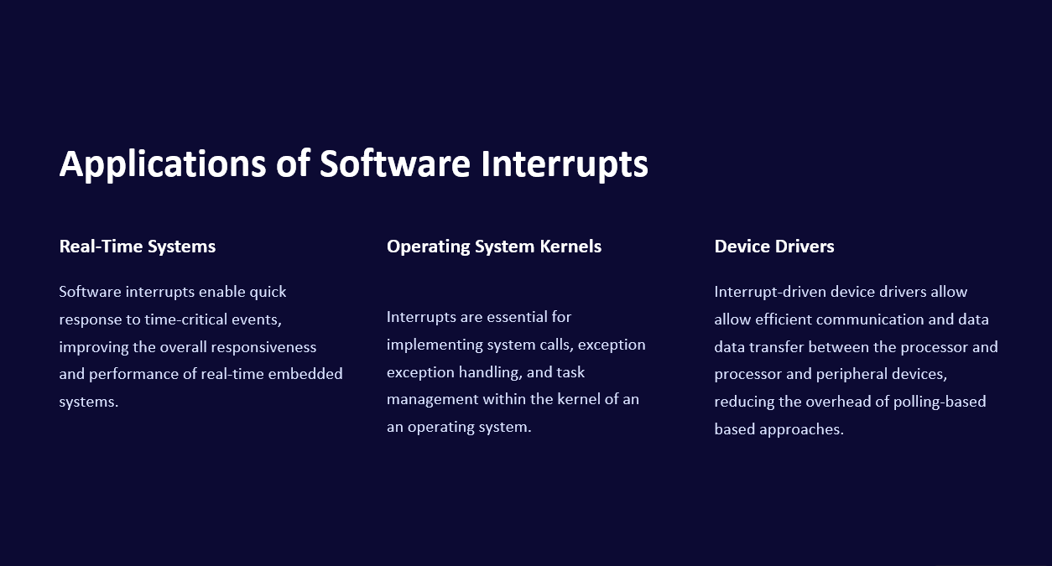
Applications of Software Interrupts
Real-Time Systems
Operating System Kernels
Device Drivers
Software interrupts enable quick response to time-critical events, improving the overall responsiveness and performance of real-time embedded systems.
Interrupt-driven device drivers allow efficient communication and data transfer between the processor and peripheral devices, reducing the overhead of polling-based approaches.
Interrupts are essential for implementing system calls, exception handling, and task management within the kernel of an operating system.

Slide 9
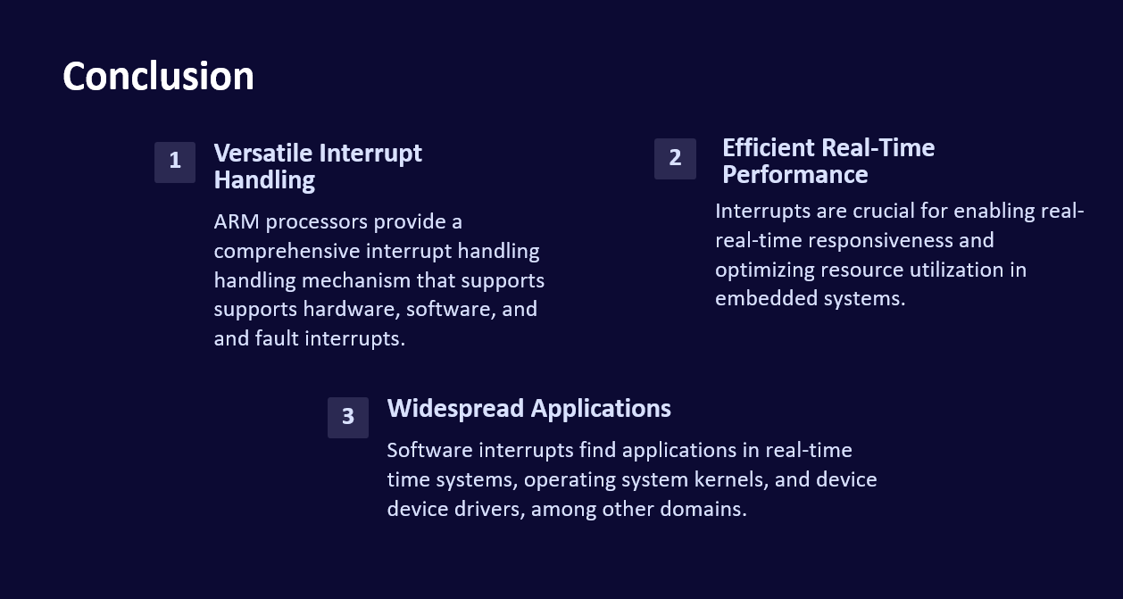
Conclusion
Versatile Interrupt Handling
2
Efficient Real-Time Performance
1
ARM processors provide a comprehensive interrupt handling mechanism that supports hardware, software, and fault interrupts.
Interrupts are crucial for enabling real-time responsiveness and optimizing resource utilization in embedded systems.
3
Widespread Applications
Software interrupts find applications in real-time systems, operating system kernels, and device drivers, among other domains.

Slide 10

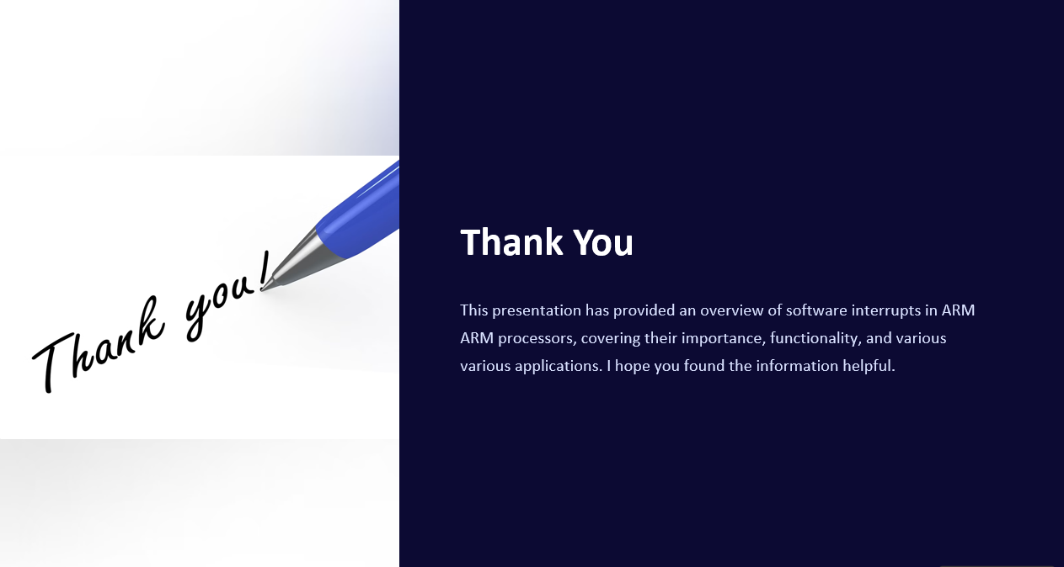

Thank You
This presentation has provided an overview of software interrupts in ARM processors, covering their importance, functionality, and various applications. I hope you found the information helpful.

